Slide 1
Machine Learning based fault diagnosis

Slide 2
Team members

Slide 3
introduction
What is a DRIVE?
Systems employed for motion control are known as Drives.
What is an Electric Drive?
Drives which employ Electric motors are known as electric drives. The key role of electric drives is to control and regulate the operation of an electric motor to meet specific performance requirements.
Block Diagram of an Electric Drive:
Power Supply: The drive receives electrical power from an AC or DC source.
Control Unit: Regulates voltage, current, and frequency to achieve the desired speed and torque.
Power Converter (Inverter/Rectifier): Converts the input power into a suitable form for the motor.
Electric Motor: Converts electrical energy into mechanical motion.
Feedback System (Sensors): Monitors motor performance and adjusts control parameters for efficient operation.

Slide 4
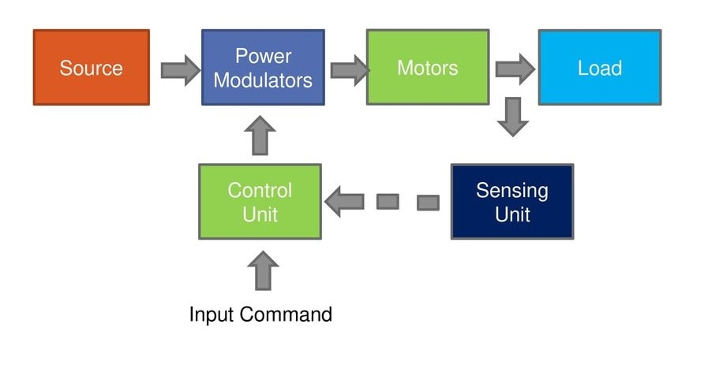
Block diagram

Slide 5
simulink
1. Analysis of the Simulink Model
The model represents a three-phase induction motor drive with fault injection for fault diagnosis using machine learning. It simulates electrical faults (phase-to-ground and phase-to-phase) and captures electrical and mechanical parameters for analysis.
2. Key Components in the Model
A. Power Supply Section
Three-Phase AC Voltage Source: Provides power with controllable voltage variations.
Inverter Circuit: Converts DC to AC for motor speed control via a Variable Frequency Drive (VFD).
PWM and MATLAB Function: Controls power delivery using frequency and clock signals.
B. Electric Drive (Induction Motor)
Converts electrical energy to mechanical motion, outputting torque, speed, and current signals.
C. Fault Injection Mechanism
Phase-to-Ground Fault: Introduces short circuit to ground, causing current imbalances.
Phase-to-Phase Fault: Simulates inter-phase faults leading to voltage/current disturbances.
D. Measurement Blocks
Torque, Speed, and Currents: Captures key performance parameters.
RMS and Scope Blocks: Measure and visualize real-time signals.
PowerGUI: Essential for electrical simulations.
3. Machine Learning-Based Fault Diagnosis
Step 1: Data Collection through Simulation
Extract phase currents, rotor speed, torque, and voltage waveforms for dataset creation.
Step 2: Machine Learning Model Selection
Train a KNN classifier using extracted features with an 80-20 train-test split.
Step 3: Model Training and Optimization
Optimize hyperparameters for accuracy, using precision, recall, and F1-score for validation.
Step 4: Fault Classification and Real-Time Deployment
Classifies conditions as Healthy, Minor Fault, or Severe Fault for early fault detection and prevention.

Slide 6
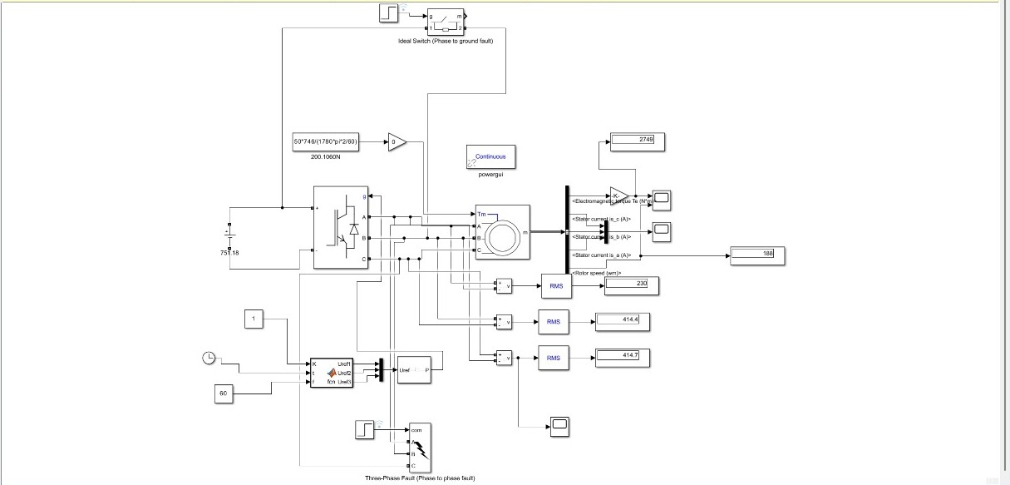
SIMULATION

Slide 7
Faults in the project
1. Phase-to-Phase Short Circuit
A phase-to-phase short circuit occurs when two of the three phases make direct contact, leading to abnormal current flow and potential damage.
Detection of Fault
Causes a surge in current in the affected phases. The two shorted phases show abnormally high current, while the third phase remains stable.
2. Phase-to-Ground Short Circuit
A phase-to-ground fault occurs when one phase unintentionally contacts the ground or a grounded structure.
Detection of Fault
The affected phase will experience abnormally high current, while the other two phases may show a significant drop.

Slide 8
THANK YOU

